Slide 1
The Internet
PHP works with the web
Notes:
PHP is primarily used to create internet sites and applications
An Internet application is a client-server application that uses standard Internet protocols for connecting the client to the server
You can also create intranet applications – things that run only inside a corporate network – for example, but the basic idea of how the internet works remains the same

Slide 2
Internet Basics
Lesson 1:
Notes:
SO the internet is a bunch of acronym soup
You don't have to know EVERYTHING but it's great to have an idea of HOW The internet works

Slide 3
What is the Internet?
The Internet is a global system of interconnected computer networks that use the standard Internet protocol suite (TCP/IP) to link several billion devices worldwide.
Notes:
Wait what? does that make sense?
So any internet application – or intranet application has two things that makes it so
It speaks TCP/IP – and usually HTTP
And it has interconnected computers
So everything speaks the same language

Slide 4
What runs the Internet
TCP/IP
HTTP
HTML/CSS
Notes:
We like acronyms
each of these things layer on top of each other to create the internet we use today

Slide 5
TCP/IP
Transmission Control Protocol (TCP) and the Internet Protocol (IP)
Notes:
TCP/IP is the communications systems that allow computers to talk to each other
all the computers use the same standard protocols
TCP/IP is closer the idea “this is the alphabet we all use” than “this is the language we all use”

Slide 6
IP
IP address -> where we’re going
IP restricts size – 64K – but doesn’t care how it gets chopped up
IP cares nothing for order or when things arrive
Notes:
This is similar to the pony express
They restricted the size of packages to assure that their 12 riders could carry multiple pieces of mail
so people weren’t waiting 5 days or more for items to be sent because 1 person sent large items

Slide 7
TCP
TCP is responsible for chopping up data
TCP is also responsible for putting it back together in the right order
TCP sends receipts for each piece of data, so if a piece is lost it can be resent
Notes:
This is similar to a smart businessman at the end of the pony express, who would break up things into packets the size that could be sent via pony express (20 pages or so)
and reassembled them at the other end – optionally they’d sent receipts, and anything not acknowledged in 10 days was replaced

Slide 8
HTTP
The Hypertext Transfer Protocol (HTTP) is an application protocol for distributed, collaborative, hypermedia information systems. Hypertext is structured text that uses logical links (hyperlinks) between nodes containing text.
Notes:
So if tcp/ip is the alphabet, this is our language
our method of giving meaning to words

Slide 9
How HTTP Works
Browser
Request
Server
Server
Response
Browser
Notes:
Your browser makes a request to the server
the server decides what to send, and sends the text response to the browser
the transmission along the wires, from computer to computer – is governed by tcp/ip
but what is transmitted and how is controlled by http

Slide 10
Features of HTTP
connectionless – make the request, then disconnect and wait for the server to talk back
media independent – anything can be sent, as long as you attach the type of content being sent
stateless – server and client only know about each other during the request, afterwards they forget it happened

Slide 11
HTTP format
Start Line
Headers
Body
Notes:
This is the basic setup for what an http request looks like – nothing fancy or exciting

Slide 12
An HTTP Request
GET /hello.htm
HTTP/1.1
User-Agent: Mozilla/4.0 (compatible; MSIE5.01; Windows NT)
Host: example.com
Accept-Language: en-us
Accept-Encoding: gzip, deflate
Connection: Keep-Alive
Notes:
http requests are all strings – strings are fun
the top line has a VERB and a URL
the second line tells us the protocol we’re using – then there are a bunch of key/value pairs that are HEADERs – additional information sent along

Slide 13
An HTTP Response
HTTP/1.1 200 OK
Date: Mon, 27 Jul 2009 12:28:53 GMT
Server: Apache/2.2.14 (Win32)
Last-Modified: Wed, 22 Jul 2009 19:15:56 GMT
Content-Length: 88
Content-Type: text/html
Connection: Closed
<html>
<body
<h1>Hello, World!</h1>
</body>
</html>
Notes:
http responses have a response code
404 is a popular one I’ve bet you’ve seen
then a bunch of key/value pairs for headers
followed by the actual text portion of the http request
notice the content-type – this is important because it tells the browser how to display things

Slide 14
HTTP Verbs
GET
POST
HEAD
PUT
DELETE
CONNECT
OPTIONS
TRACE
Notes:
the only ones you’re going to use with most php websites is get and post
if you create web services, you might use some of the other http verbs but that’s not something for a beginner to worry about

Slide 15
HTTP RESPONSES
1xx: Informational
It means the request has been received and the process is continuing.
2xx: Success
It means the action was successfully received, understood, and accepted.
3xx: Redirection
It means further action must be taken in order to complete the request.
4xx: Client Error
It means the request contains incorrect syntax or cannot be fulfilled.
5xx: Server Error
It means the server failed to fulfill an apparently valid request.
Notes:
Again – most of these will be handled for you either by the server or PHP
but you should still understand the basics of these reponses, and that each set has a different purpose

Slide 16
Clients
Your browser
Safari
Chrome
Firefox
IE
Tools
curl
Programs
requesting via code
Notes:
Clients take the information provided by an http request and do something with it
browsers are the most common tool, although you can also make http requests programmatically or through tools such as curl
your browser is the most important thing, however, because your browser speaks a special language – that language is HTML(css)(js)

Slide 17
HTML and CSS (and JavaScript)
HTML (the Hypertext Markup Language) and CSS (Cascading Style Sheets) are two of the core technologies for building Web pages. HTML provides the structure of the page, CSS the (visual and aural) layout, for a variety of devices
JavaScript – browser embedded programming language
Notes:
html and css are the “grammar” – a standard method of markup and display for data

Slide 18
Remember - PHP is on the Server
PHP creates text sent back as an HTTP response
This is Server Side Processing
To interact on the client, use JavaScript
Notes:
This idea that PHP is only on the server is a very important idea
Concept of “shared nothing” for PHP as well

Slide 19
Redirects and Headers
Lesson 3:
Notes:
how we send you around after you login/logout, post a form, etc.

Slide 20
Header Redirect
<?php
header('Location: http://www.newpage.com');
exit;
Notes:
- GET in the URL, can bookmark - both still sent in plain text in the headers

Slide 21
Basic Html
Lesson 2:
Notes:
Html, css, javascript, boostrap as css framework magic

Slide 22
HTML Page Parts
<!DOCTYPE html>
<html></html>
<head></head>
<body></body>

Slide 23
HTML Tags
HTML uses opening and closing tags to start and stop sections:
Title: <title>Some text</title>
Div: <div>Some text</div>
Paragraph: <p>Some text</p>
Span: <span>Some text</span>

Slide 24
HTML Tags
HTML uses opening and closing tags to start and stop formatting:
Italics (emphasis): <em>Some text</em>
Bold: <strong>Some text</strong>
Link: <a href="http://url.com">Link Text</a>
Headings: <h1>Some text</h1>

Slide 25
HTML Tags
Some HTML tags stand alone:
Line Break: <br>
Special Characters, like "<": &lt;

Slide 26
Exercise
Create an HTML page with a title of "A Simple Form" that says "Welcome!" in an H1 heading and followed by "Please fill out the form below:" enclosed in paragraph tags.

Slide 27
Solution
<!DOCTYPE html>
<html>
<head>
<title>A Simple Form</title>
</head>
<body>
<h1>Welcome!</h1>
<p>Please fill out the form below:</p>
</body>
</html>
Notes:
- GET in the URL, can bookmark - both still sent in plain text in the headers

Slide 28
Forms
Lesson 4:
Notes:
Get, post, validation – for now data is just stored in arrays and/or thrown away

Slide 29
HTTP in PHP
$_GET versus $_POST
Notes:
- GET in the URL, can bookmark - both still sent in plain text in the headers

Slide 30
Basic Form Tags
<form action="index.php" method="POST">
<label>
First Name:<br>
<input type="text" name="firstName" value="">
</label>
</form>
Notes:
- GET in the URL, can bookmark - both still sent in plain text in the headers

Slide 31
Input Types
<label>
Textbox (1 line):
<input type="text" name="firstName" value="">
</label>
<label>
Textarea (multi-line):
<textarea name="fieldName"></textarea>
</label>

Slide 32
Input Types
Radio Buttons (choose one):
<input type="radio" name="chooseOne" value="1"> 1
<input type="radio" name="chooseOne" value="2"> 2
<input type="radio" name="chooseOne" value="3"> 3
Check Boxes (choose multiple):
<input type="checkbox" name="choices[]" value="1"> 1
<input type="checkbox" name="choices[]" value="2"> 2
<input type="checkbox" name="choices[]" value="3"> 3

Slide 33
Input Types
Drop-down:
<select name="fieldName">
<option value="1"> First Choice</option>
<option value="2"> Second Choice</option>
<option value="3"> Third Choice</option>
</select>

Slide 34
Input Types
Hidden fields:
<input type="hidden" name="status" value="text">
Submit Button:
<input type="submit" name="submitButton" value="Go">
Reset Button:
<input type="reset" name="resetButton" value="Clear the Form">

Slide 35
Exercise
On your HTML page from the previous exercise, create a form using POST with a text field for first name and a text field for email address. Then, have a set of radio buttons for choosing favorite color (have at least three options). Next, have a set of checkboxes for choosing which pets you have (have at least three options). Finally, have a submit button that says "Submit my data".

Slide 36
Solution
<form action="index.php" method="post">
<p>First Name:<br>
<input type="text" name="firstName" value=""></p>
<p>Email Address:<br>
<input type="text" name="email" value=""></p>
<p>Favorite Color:<br>
<input type="radio name="favColor" value="Red"> Red<br>
<input type="radio name="favColor" value="Green"> Green<br>
<input type="radio name="favColor" value="Blue"> Blue</p>
Notes:
- GET in the URL, can bookmark - both still sent in plain text in the headers

Slide 37
Solution
<p>Pets:<br>
<input type="checkbox name="pets[]" value="Dog"> Dog<br>
<input type="checkbox name="pets[]" value="Cat"> Cat<br>
<input type="checkbox name="pets[]" value="Turtle"> Turtle</p>
<input type="submit" name="submitButton" value="Submit my data">
</form>
Notes:
- GET in the URL, can bookmark - both still sent in plain text in the headers

Slide 38
Where does the data go?
All form data comes into PHP as a string.
$_GET or $_POST
<input type="text" name="firstName" value="">
$_POST['firstName']
<input type="checkbox" name="choice[]" value="Red">
$_POST['choice'][0]

Slide 39
Superglobal contents
Contains all form data, including submit button and hidden fields
<input type="submit" name="submitButton" value="Submit my data">
echo $_POST['submitButton'];
//Submit my data

Slide 40
Exercise
Update your form script so that it checks the value of the submit button. If the form has not been submitted, display the form. If the form has been submitted, display the values of the form.

Slide 41
Solution
if ($_POST['submit'] == "Submit my data") {
echo "Name: {$_POST['firstName']}<br> Email: {$_POST['email']}<br> Favorite Color: {$_POST['favColor']}<br>
Pets: " . implode(',', $_POST['pets']) . "<br>";
}
else {
//form code
}
Notes:
- GET in the URL, can bookmark - both still sent in plain text in the headers

Slide 42
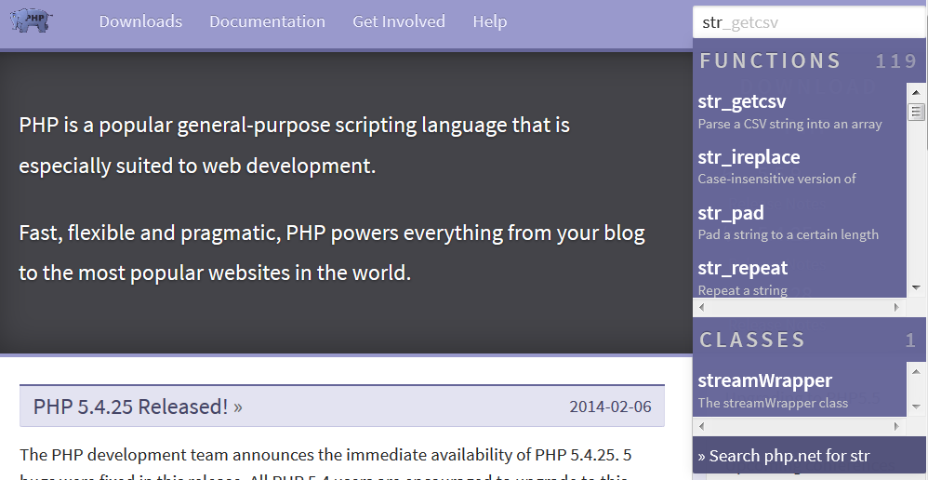
php.net
Or, go directly to: http://www.php.net/strlen

Slide 43
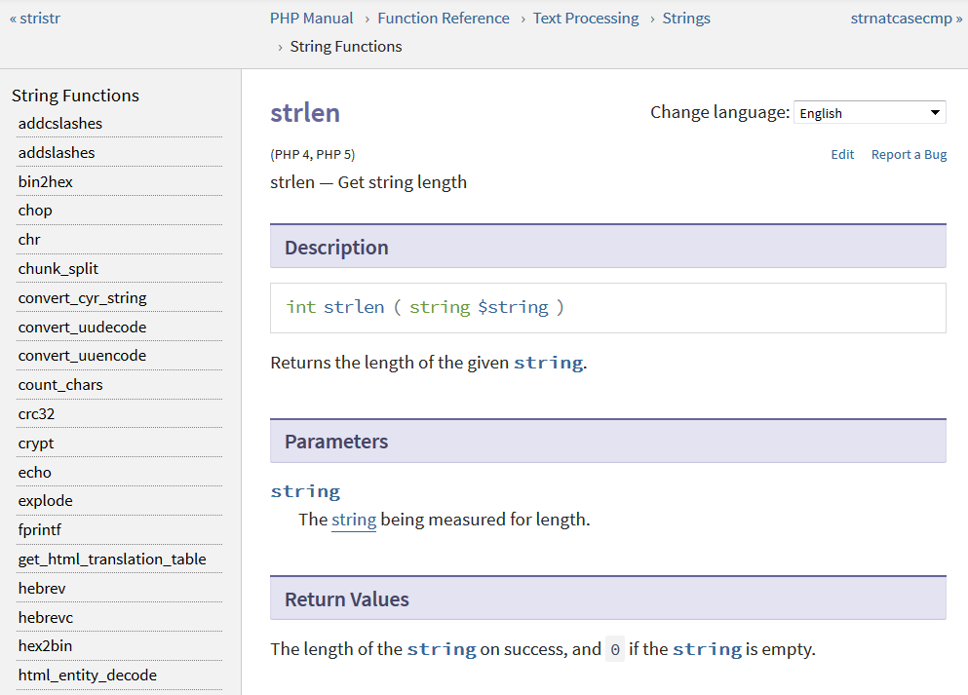
Function Pages

Slide 44
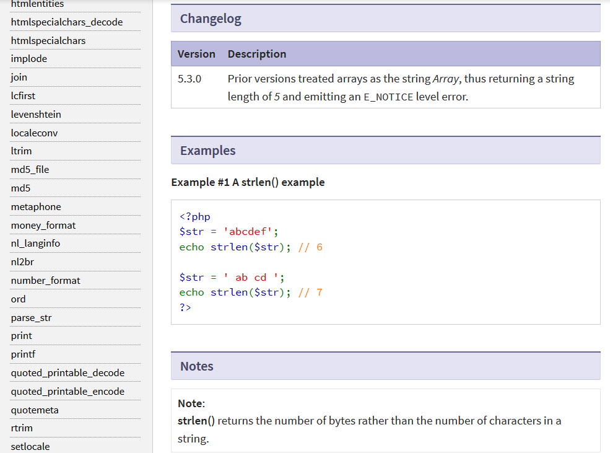

Slide 45
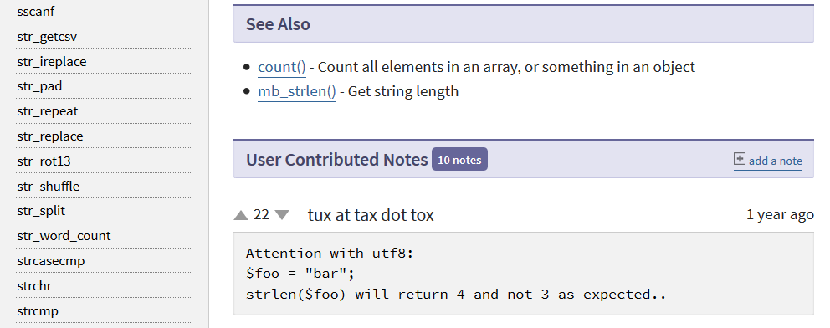

Slide 46
Validate Input, Escape Output
Nothing from an external source (like $_POST or $_GET) can be trusted.
Focus on validating when bringing data into your form.
Always escape the data whenever it is leaving your script.
Notes:
Even if it's a hidden field where you set the value, you cannot trust it because someone else can create a form that uses that hidden field and posts to your script, which means they can control what goes into that field in your script.

Slide 47
Simple Validation
Character Type Checking Functions: http://php.net/ctype
//Checks for digits only
if (ctype_digit($_POST['myVar'])) {
echo "Yes, this contains only digits";
}

Slide 48
Simple Validation
Filter variables http://php.net/filter_var
//Checks for a valid URL
if (filter_var($_POST['url']), FILTER_VALIDATE_URL) {
echo "Yes, this is a URL";
}

Slide 49
Simple Escaping
Convert all applicable characters to their HTML entities http://php.net/htmlentities
$myVar = "<b>text</b>";
echo htmlentities($myVar);
//&lt;b&gt;text&lt;b&gt;

Slide 50
Simple Escaping
Remove HTML and PHP tags http://php.net/strip_tags
$myVar = "<b>text</b>";
echo strip_tags($myVar);
//text
Notes:
Can cause unexpected results if there are less than symbols that are not part of a tag.

Slide 51
Exercise
Take a look at: http://php.net/manual/filter.filters and validate the data you are bringing in through your form. If it validates, then display the data.
Escape the data before displaying it on the page.

Slide 52
Solution
if (ctype_alpha($_POST['firstName'])) {
echo "Name: " . htmlentities($_POST['firstName']) . "<br>";
}
if (filter_var($_POST['email']), FILTER_VALIDATE_EMAIL) {
echo "Email: " . htmlentities($_POST['email']) . "<br>";
}
if (($_POST['favColor'] == "Red") || ($_POST['favColor'] == "Green") || ($_POST['favColor'] == "Blue")) {
echo "Favorite Color: " . htmlentities($_POST['favColor'])
. "<br>";
}
$theirPets = implode(',', $_POST['pets']);
if (ctype_alpha(str_replace(',', '', $theirPets)) {
echo "Pets: " . htmlentities($theirPets) . "<br>";
}

Slide 53
Using Forms
When a validation test fails, make it easy for your user to fix it (Check for malicious submissions, but always treat your users as though it were an accident).

Slide 54
Solution
$checkVar = "Bad";
if ($_POST['submit'] == "Submit my data") {
//Check your validation if ($var == "good") {
$checkVar = "Good";
}
else {
$checkVar = "Bad";
}
}
if ($checkVar == "Good") {
//display submitted data
}
else {
//form code
}
Notes:
- GET in the URL, can bookmark - both still sent in plain text in the headers

Slide 55
Refill the Form
Don't make your users practice their typing skills. Always refill non-malicious data.
Personal Habit: When I validate my data, I assign it to a local variable, so I know I'm using my validated data.

Slide 56
Example
<form action="index.php" method="post">
<p>First Name:<br>
<input type="text" name="firstName" value="$firstName"></p>
<p>Email Address:<br>
<input type="text" name="email" value="$email"></p>
Notes:
- GET in the URL, can bookmark - both still sent in plain text in the headers

Slide 57
Example
<p>Favorite Color:<br>
<input type="radio name="favColor" value="Red"<?php if($favColor == "Red") { echo " checked"; } ?>> Red<br>
Echo '<input type="radio name="favColor" value="Green"';
if ($favColor == "Green") {
echo " checked";
}
echo '> Green<br>';
Notes:
- GET in the URL, can bookmark - both still sent in plain text in the headers

Slide 58
Example
echo '<p>Pets:<br>
<input type="checkbox name="pets[]" value="Dog"';
if (in_array("Dog", $pets) {
echo " checked";
}
echo '> Dog<br>
<input type="checkbox name="pets[]" value="Cat"> Cat<br>
<input type="checkbox name="pets[]" value="Turtle"> Turtle</p>';
Notes:
- GET in the URL, can bookmark - both still sent in plain text in the headers

Slide 59
Sessions and COOKIES
Lesson 5:
Notes:
starting a session
doing a "login" by not really checking a username and password and setting a session variable
unset a session variable to logout

Slide 60
Accessing the Data
Sessions:
Server-side
Less picky on header timing (but still picky)
Cookies:
Client-side
Must occur before headers are sent
Both:
Allow data to be stored by one script and accessed by another
Accessible via superglobal array

Slide 61
Using Sessions
Place this at the very top of your page:
session_start();
This must occur before headers are sent. Things that will send the headers:
the HTML declarations
Whitespace
echo'ing anything

Slide 62
Example
session_start();
$_SESSION['custName'] = $_POST['firstName'];
Notes:
- GET in the URL, can bookmark - both still sent in plain text in the headers

Slide 63
Example
session_start();
echo "Hello, {$_SESSION['custName']}. Welcome back!";
Notes:
- GET in the URL, can bookmark - both still sent in plain text in the headers

Slide 64
Example
setcookie("custName", $_POST['firstName']);
header("Set-Cookie: custName=$_POST['firstName']; custEmail=$_POST['email']");
Notes:
- GET in the URL, can bookmark - both still sent in plain text in the headers

Slide 65
Example
echo "Hello, {$_COOKIE['custName']}. Welcome back!";
Notes:
- GET in the URL, can bookmark - both still sent in plain text in the headers

